Slide 1
Online Learning Applications Project
10663546
10663556
10663178
Guido Mancinelli
Pietro Messina
Niccolò Nicolosi

Slide 2
First Requirement
Pricing and Bidding in a stochastic environment

Slide 3
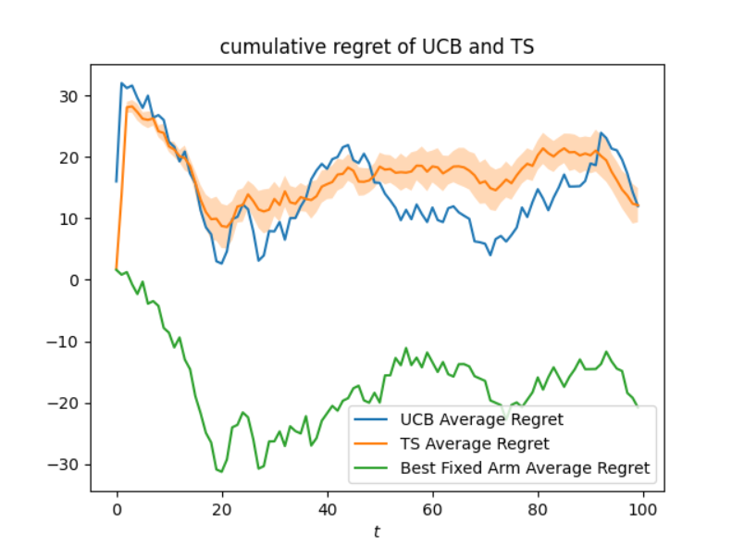
Pricing
Stochastic setting
Baseline in expectation
Gaussian processes
GP-UCB and GP-TS agents
The regret is not only sublinear, but also does not grow and oscillates around small values.
This behaviour is obtained due to a “lucky” rewards distribution of the environment, as can be seen by the regret obtained by an hypothetical agent playing the best arm and observing the empirical rewards.
This agent obtains a negative regret wrt the clairvoyant, which observes the rewards in expectation.

Slide 4
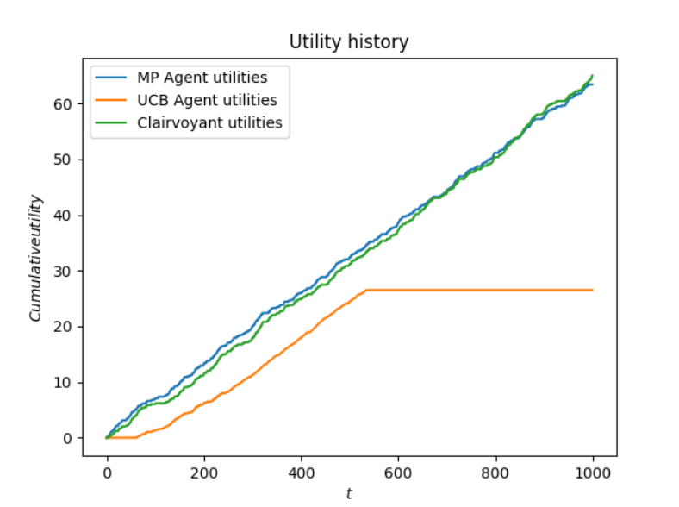
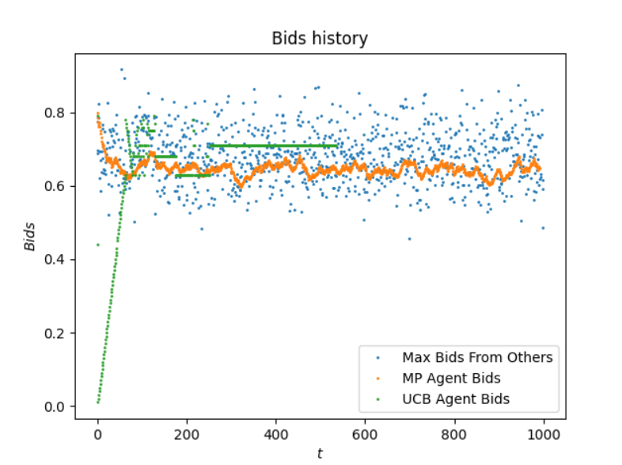
Bidding
Truthful, second-price auction
Agent valuation of 0.8
MP and UCB-like agents
For the bidding algorithms, a slight variation of what was seen during lecture has been used, as the per-round budget is not fixed at the beginning of the auctions but instead updated after each one.
This proves to be an effective strategy in order to fully exploit the budget and avoid to finish it too early.
In a truthful auction setting, MP proves to be an effective agent as its utilities rival the ones of the clairvoyant.
On the other hand, the UCB-like approach seen for the non-truthful auctions struggles to find the best bid and ends up finishing the budget too son.

Slide 5
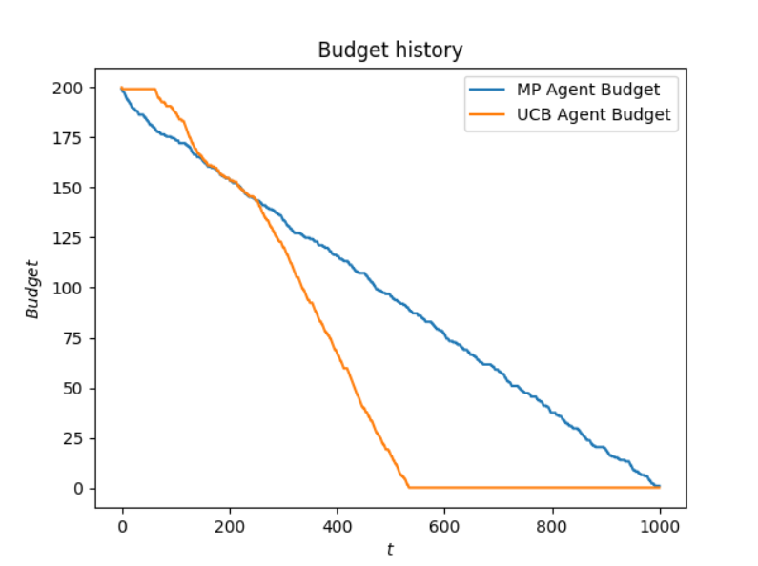
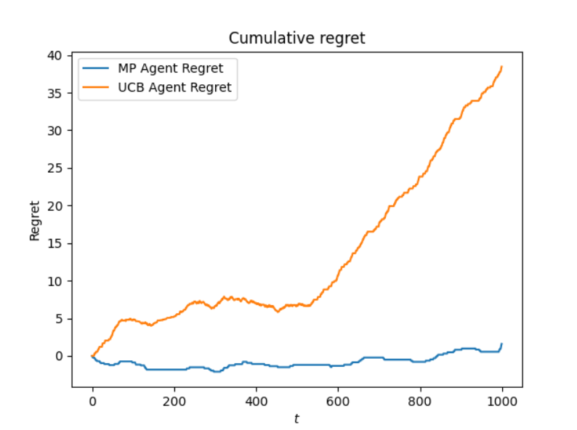
Bidding
The cumulative regret is strictly sublinear for MP, while UCB manages to keep a sublinear regret before finishing the budget

Slide 6
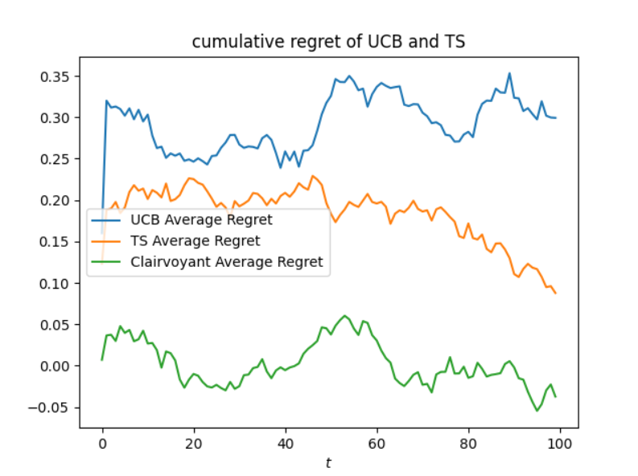
Pricing and Bidding
In this setting, each day:
The pricing algorithm (GP-UCB) sets a price
The corresponding valuation is set as the expected reward of the selected price. An estimation of the expected reward is provided by the employed pricing algorithms, which rely on Gaussian Processes to do so. (Actually, UCBs were used due to technical reasons)
The bidding algorithm relies on MP to compete in 1000 auctions per day, winning some of them
If the ad is clicked, a user visits the webpage
With a probability, the user buys the product. At the end of the day, the pricing algorithm updates its estimates basing on the observed data

Slide 7
Pricing and Bidding
The clairvoyant considered to plot the cumulative regret is built on the pricing step alone for a fair competition.
Therefore, the utilities have been normalized on the number of user which visit the page, and they do not take into consideration the fact that choosing higher prices leads to being able to win more auctions, meaning more users visiting the website and more of them buying the product, albeit with a low probability

Slide 8
Second Requirement
Pricing and Bidding in an adversarial environment

Slide 9
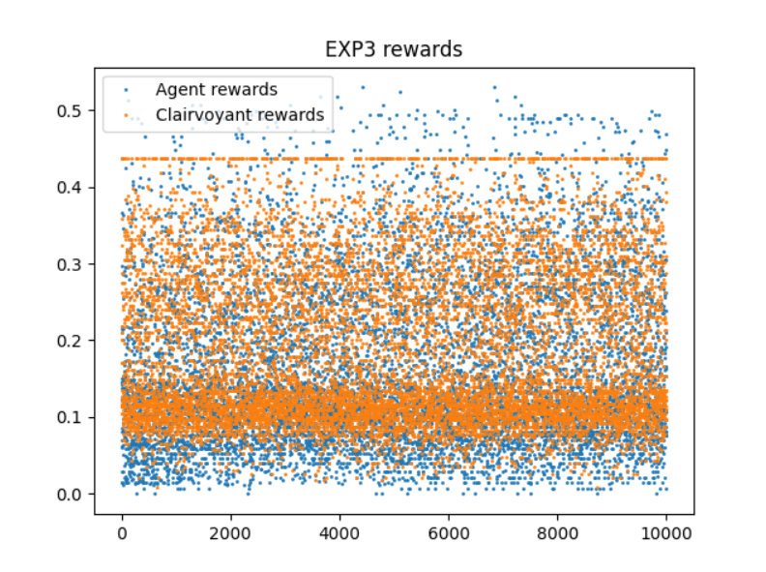
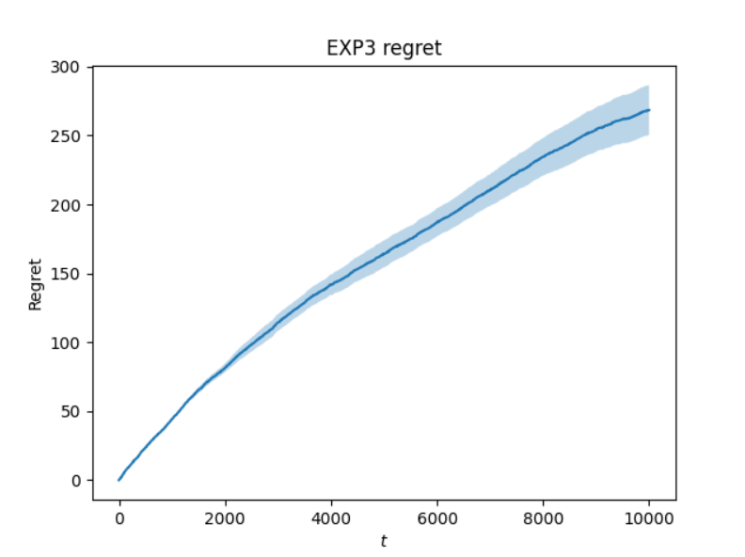
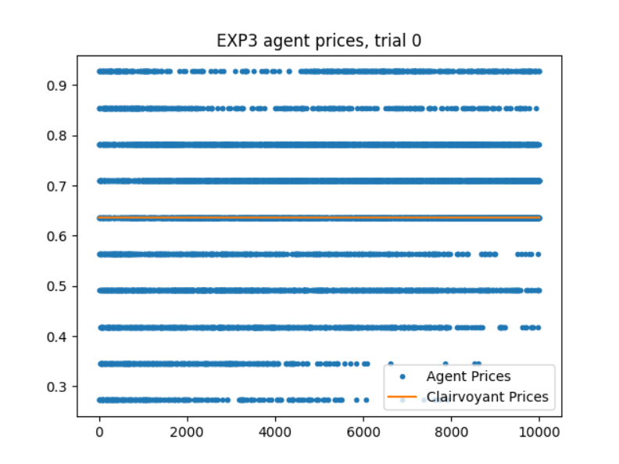

Pricing
Adversarial setting, built using demand curves changing each day
Baseline observes the demand curves for each day, and plays the best fixed one in hindsight
The problem becomes an adversarial MAB
Exp3 has been employed, achieving sub-linear regret
The learning rate is set as the optimal one:
$$η=\sqrt{\frac{logK}{KT}}$$

Slide 10
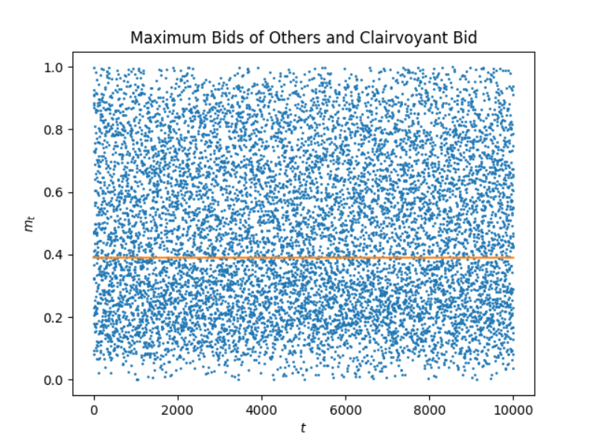
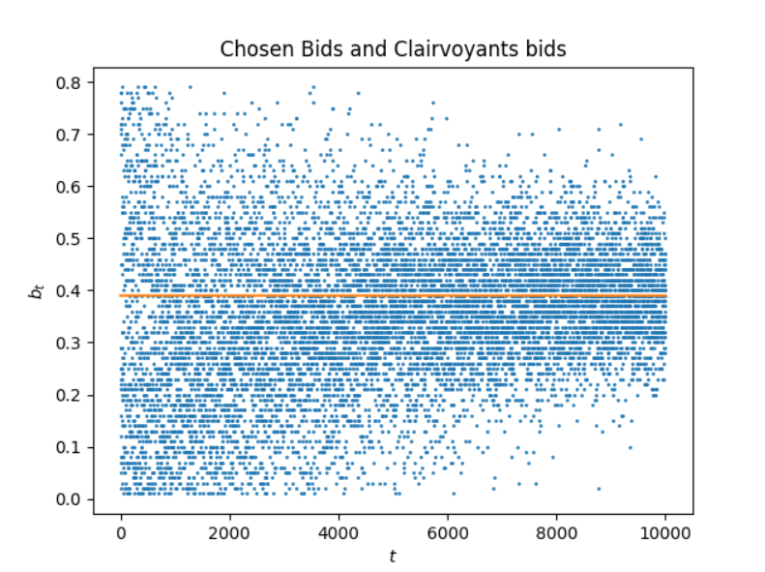
Bidding
The bids of the other advertisers are randomly generated each time, subject to a specific upper bound. This is specified by a normal distribution having the mean which follows a fast sinusoid.
In this way, the periodicity is completely removed, as is the stochastic behavior. The adversarial environment is hence fully represented, being impossible to make any assumption on the distribution of the bids

Slide 11
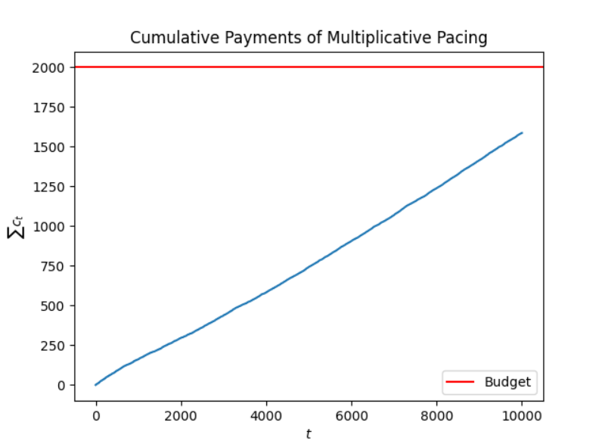
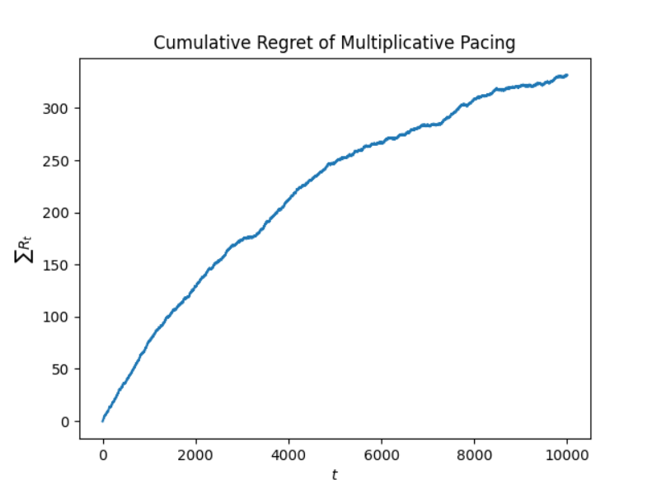
Bidding
Generative Multiplicative Pacing shows sublinear regret

Slide 12
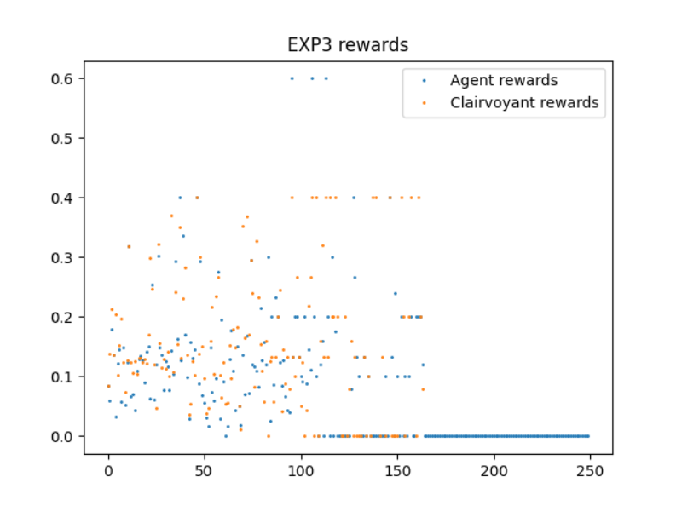
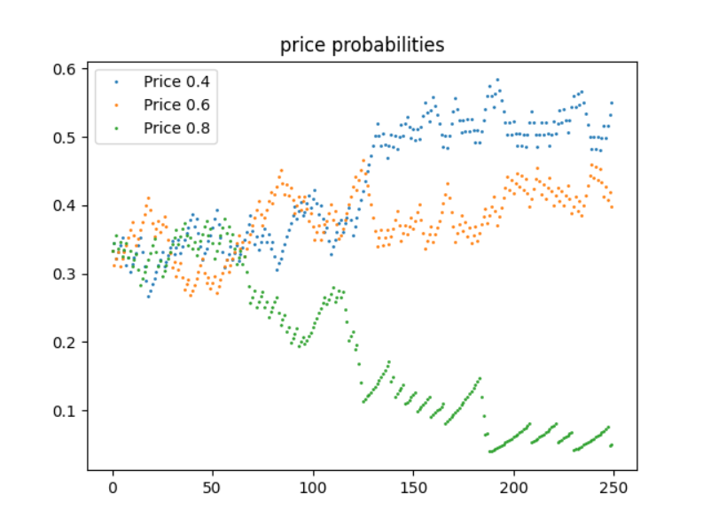
Pricing and Bidding
The plots for price probabilities and EXP3 rewards are drawn for every trial.
The following plots show the updates on the probabilities for each price set by Exp3

Slide 13
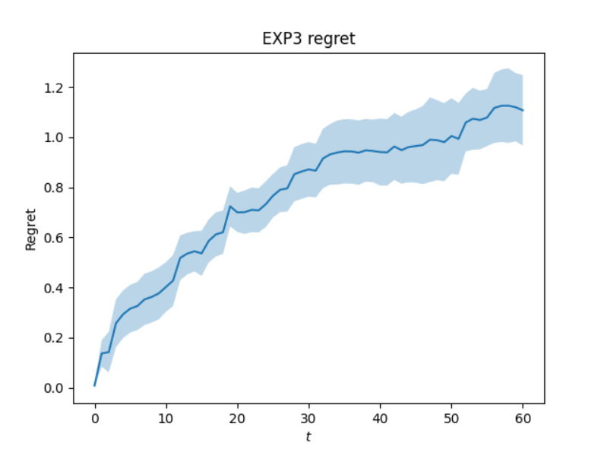
Pricing and Bidding
This is the regret obtained over 10 seeded trials against a clairvoyant built using the same considerations explained in slide 7

Slide 14
Third Requirement
Non-Stationary Environment

Slide 15
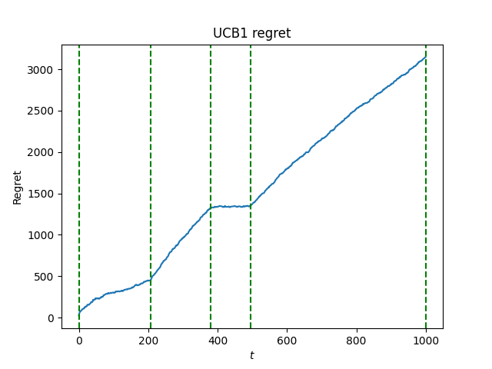
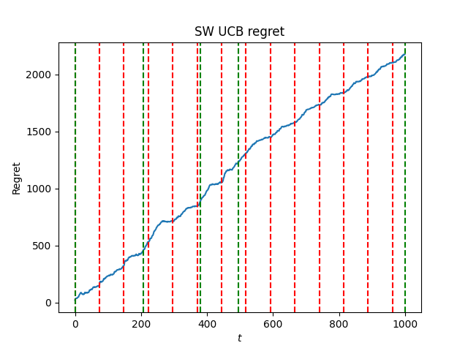
Pricing
In order to set a pricing strategy with discretization, UCB1 with the implementation of a sliding window is employed. Differently from a stochastic environment, to decide the discretization, W is used instead of T, resembling the “memory” of the algorithm
SW-UCB has slight performance dips at multiples of W. This is because the worst arms, which were pulled once at the start of the window and never again, are removed from the window and have to be pulled once again

Slide 16
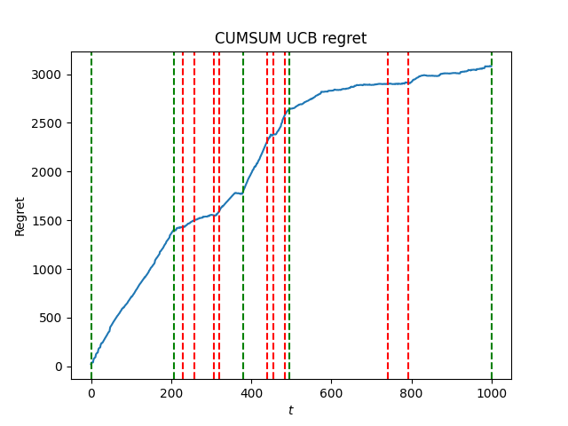
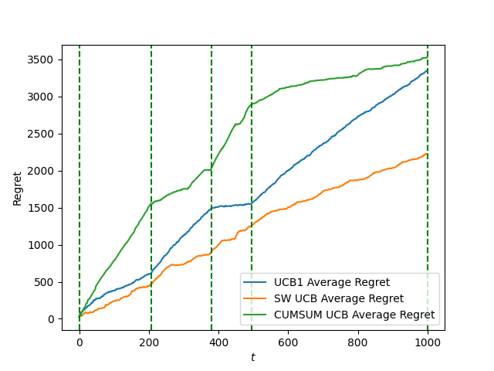
Pricing
For the CUSUM-UCB algorithm, a smaller discretization is possible: (T/n_{c})^{-1/3} , where n_{c} is the number of changes, assumed to be known. Notice that to compute the regrets of each singular algorithm, the discretization for the baseline has been taken equal to the one of the algorithm
For the comparison of the three algorithms, a wider discretization for the baseline has been instead considered, taking into account the different used discretizations. This, however, adds a linear component to the regret since the clairvoyant can exploit prices which may not be available to the other agents

Slide 17
Third Requirement (Bonus)
Non-Stationary Environment

Slide 18
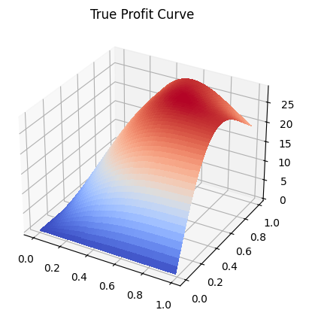
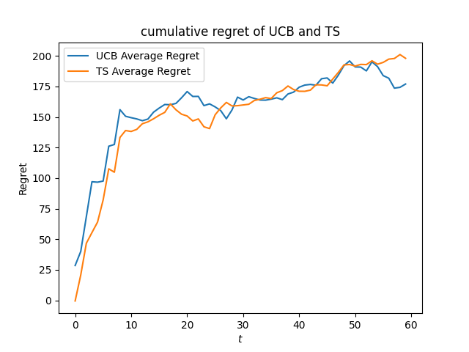
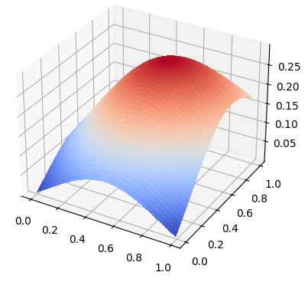
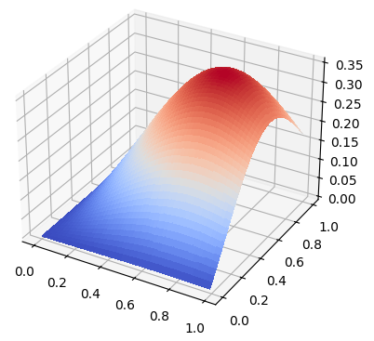
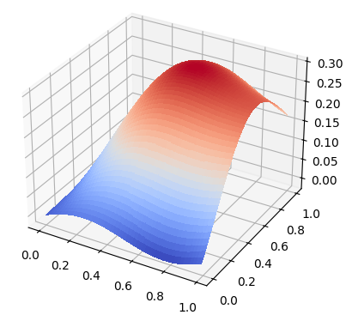
Pricing with two products
Learning the best prices of two related products was accomplished by the use of two-dimensional gaussian processes. Both GPUCB and GPTS achieve comparable sublinear regret in a relatively short time
Estimated Profit Curve Evolution
The two approaches iteratively estimate the true profit curve leveraging the assumption that similar prices lead to similar rewards. This assumption makes the problem computationally inexpensive and allows fast convergence

Slide 19
Fourth Requirement
Competition amongst different algorithms

Slide 20
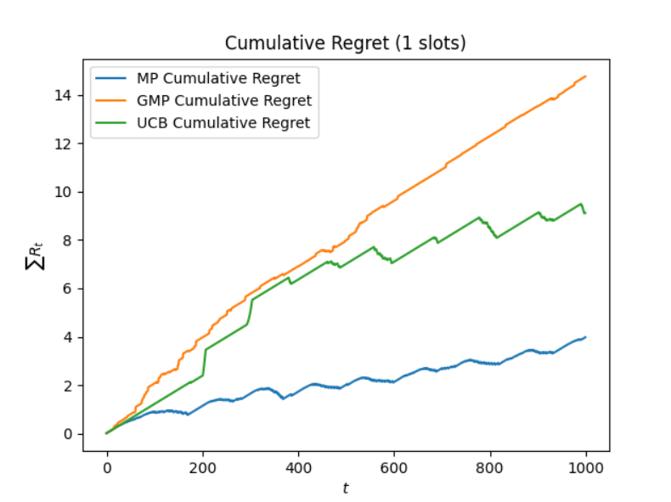
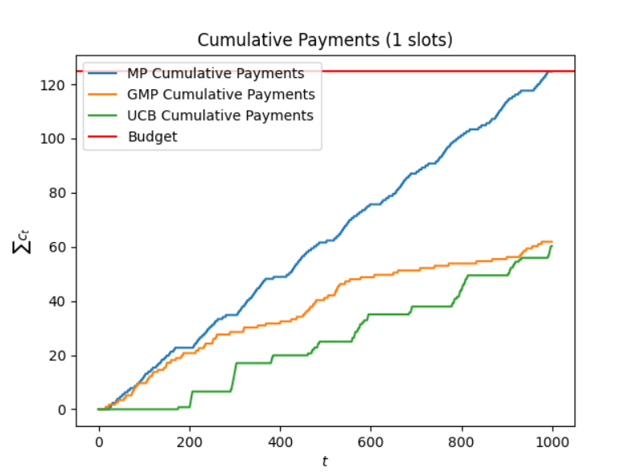
Bidding Comparisons
Finally, an environment where different agents are competing against each other is created. Three MP agents, three GMP agents and three UCB agents are considered, and the results are plotted with respect to just one agent for each algorithm

Slide 21
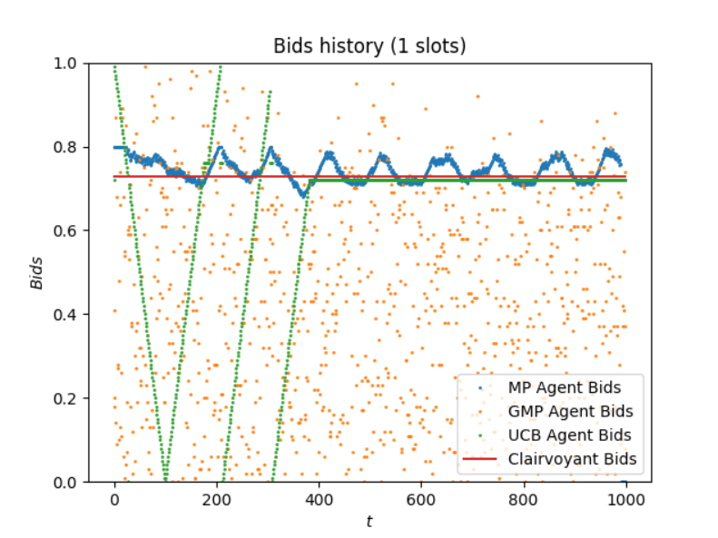
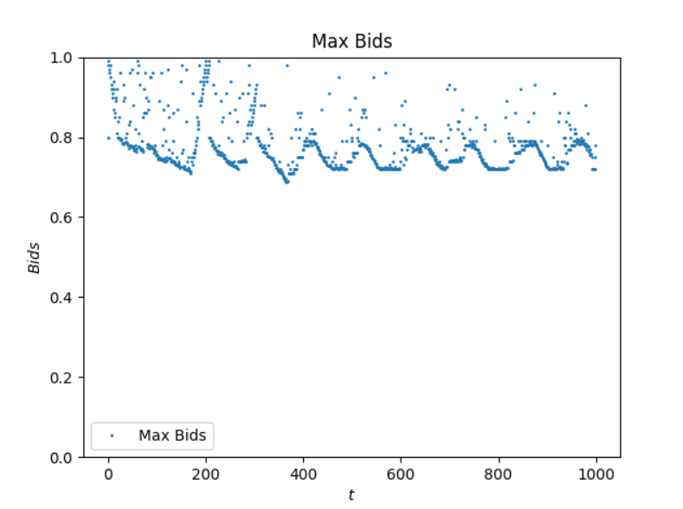
Bidding Comparisons
The behavior of the agents is shown, highlighting the resulting maximum bids.
Due to the competitiveness of the environment, UCB initially struggles to win auctions and resorts to continuous exploration of the arms, resulting in the periodic behavior.

Slide 22
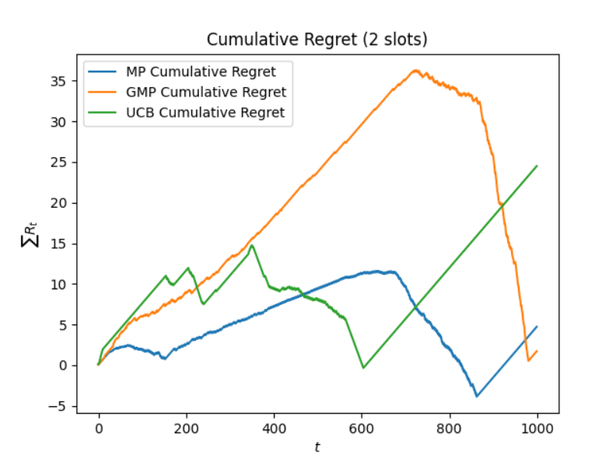
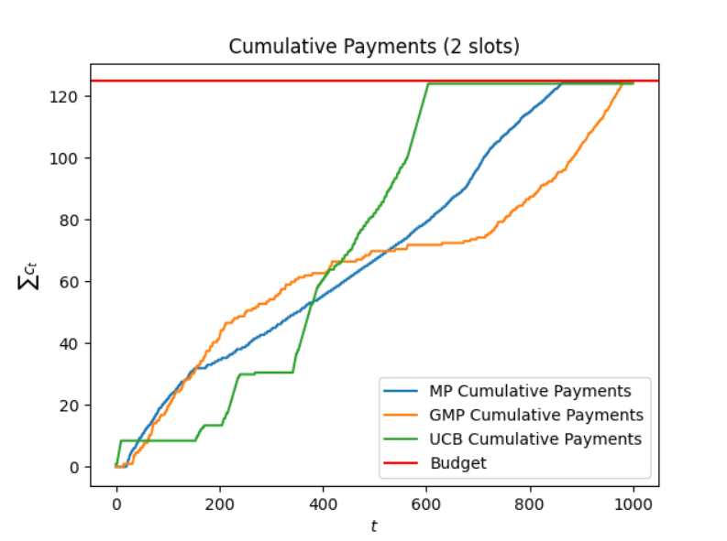
Bidding Comparisons
The environment is then modified, in order to represent an auction where two slots can be assigned.
Even if the setting is of generalized first-price auctions, MP peculiarly seems to perform better than other algorithms.
In this case is more evident how each agent’s performance is affected by that of its competitors, in particular when one of them depletes its budget.
For instance, after the UCB consumes its budget, the regret of both the other agents experiences a sharp decline

Slide 23
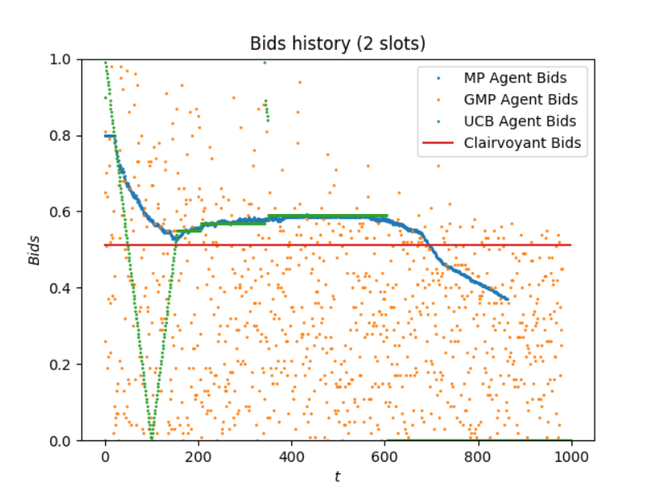
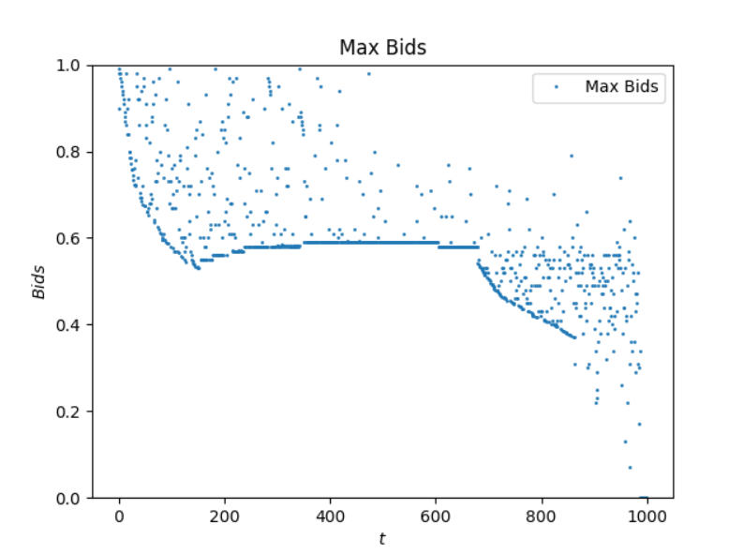
Bidding Comparisons
As before, the behavior of the agents is shown, highlighting the resulting maximum bids

